Slide 1



Discrete Mathematics for
Computer Science
Department of Computer Science
Instructor: Dr Ayesha Altaf
Reference Book: Discrete Mathematics and its applications BY Kenneth H. Rosen – 8th edition

Slide 2


2.1 Sets
 A set is a new type of structure, representing an unordered collection (group) of zero or more distinct (different) objects. The objects are called elements or members of the set.
 Notation: x ∈ S
 Set theory deals with operations between, relations among, and statements about sets.

Slide 3
2.1 Sets
The objects are called the elements or members of the set.
Sets are denoted by capital letters A, B, C …, X, Y, Z.
The elements of a set are represented by lower case letters a, b, c, … , x, y, z.
If an object x is a member of a set A we write x Î A, which reads “x belongs to A” or “x is in A” or “x is an element of A”, otherwise we write x ÏA, which reads “x does not belong to A” or “x is not in A” or “x is not an element of A”.

Slide 4

Basic Properties of Sets
 Sets are inherently unordered:
 No matter what objects a, b, and c denote,
{a, b, c} = {a, c, b} = {b, a, c} =
{b, c, a} = {c, a, b} = {c, b, a}.
 All elements are distinct (unequal); multiple listings make no difference!
 If a = b, then {a, b, c} = {a, c} = {b, c} =
{a, a, b, a, b, c, c, c, c}.
 This set contains (at most) 2 elements!

Slide 5

Basic Notations for Sets
 TABULAR FORM
Listing all the elements of a set, separated by commas and enclosed within braces or curly brackets{}.
EXAMPLES
A = {1, 2, 3, 4, 5} is the set of first five Natural Numbers.
B = {2, 4, 6, 8, …, 50} is the set of Even numbers up to 50.
C = {1, 3, 5, 7, 9, …} is the set of positive odd numbers.
NOTE
The symbol “…” is called an ellipsis. It is a short for “and so forth.”
We can denote a set S in writing by listing all of its elements in curly braces:
 {a,b,c} is the set whose elements are a, b, and c

Slide 6
Basic Notations for Sets
 DESCRIPTIVE FORM:
Stating in words the elements of a set.
EXAMPLES
A = {1, 2, 3, 4, 5}
A = set of first five Natural Numbers(Descriptive Form)
B = {2, 4, 6, 8, …, 50}
B = set of positive even integers less or equal to fifty.
C = {1, 3, 5, 7, 9, …}
C = set of positive odd integers. (Descriptive Form )

Slide 7
Basic Notations for Sets
 Set builder notation:
 For any statement P(x) over any domain,
{x | P(x)} is the set of all x such that P(x) is true
 Example: {1, 2, 3, 4}
= {x | x is an integer where x > 0 and x < 5 }
= {x∈Z | x > 0 and x < 5 }

Slide 8
SUBSET
 SUBSET: If A & B are two sets, A is called a subset of B, written A ⊆ B, if, and only if, any element of A is also an element of B. Symbolically: A ⊆ B ⇔ if x ∈ A then x ∈ B
 REMARK:
1. When A ⊆ B, then B is called a superset of A.
2. When A is not subset of B, then there exist at least one x ∈ A such that x ∉B.
3. Every set is a subset of itself.
 EXAMPLES:
A = {1, 3, 5} B = {1, 2, 3, 4, 5} C = {1, 2, 3, 4} D = {3, 1, 5}
A ⊆ B ( Because every element of A is in B )
C ⊆ B ( Because every element of C is also an element of B )

Slide 9
Proper SUBSET
 SUBSET: Let A and B be sets. A is a proper subset of B, if, and only if, every element of A is in B but there is at least one element of B that is not in A, and is denoted as A ⊂ B.
EXAMPLE:
Let A = {1, 3, 5} B = {1, 2, 3, 5}
then A ⊂ B ( Because there is an element 2 of B which is not in A).
Try Yourself! Prove that empty set is a subset of any set.

Slide 10

Definition of Set Equality
 Two sets are declared to be equal if and only if they contain exactly the same elements.
 In particular, it does not matter how the set is defined or denoted.
 Example:
The set {1, 2, 3, 4}
= {x | x is an integer where x > 0 and x < 5}
= {x | x is a positive integer where x² < 20}

Slide 11

Infinite Sets
 Conceptually, sets may be infinite
(i.e., not finite, without end, unending).
 Symbols for some special infinite sets:
N = {0, 1, 2,…} the set of Natural numbers.
Z = {…, –2, –1, 0, 1, 2,…} the set of Integers. Z⁺ = {1, 2, 3,…} the set of positive Integers.
Q = {p/q | p,q ∈ Z, and q ≠ 0}
the set of Rational numbers.
R = the set of “Real” numbers.

Slide 12

Basic Set Relations
 x∈S (“x is in S”) is the proposition that object x
is an ∈lement or member of set S.
 e.g. 3 ∈ N,
a ∈ {x | x is a letter of the alphabet}
 Can define set equality in terms of ∈ relation:
∀S,T: S = T ↔ [∀x (x∈S ↔ x∈T)]
“Two sets are equal iff they have all the same members.”
 x∉S ≡ ¬(x∈S) “x is not in S”

Slide 13

The Empty Set
.
 ∅ (“null”, “the empty set”) is the unique set that contains no elements whatsoever.
 ∅ = { } = {x | False}
 No matter the domain of discourse, we have the axiom ¬∃x: x∈∅.
 { } ≠ {∅} = { { } }
 {∅} it isn’t empty because it has ∅ as a member!

Slide 14
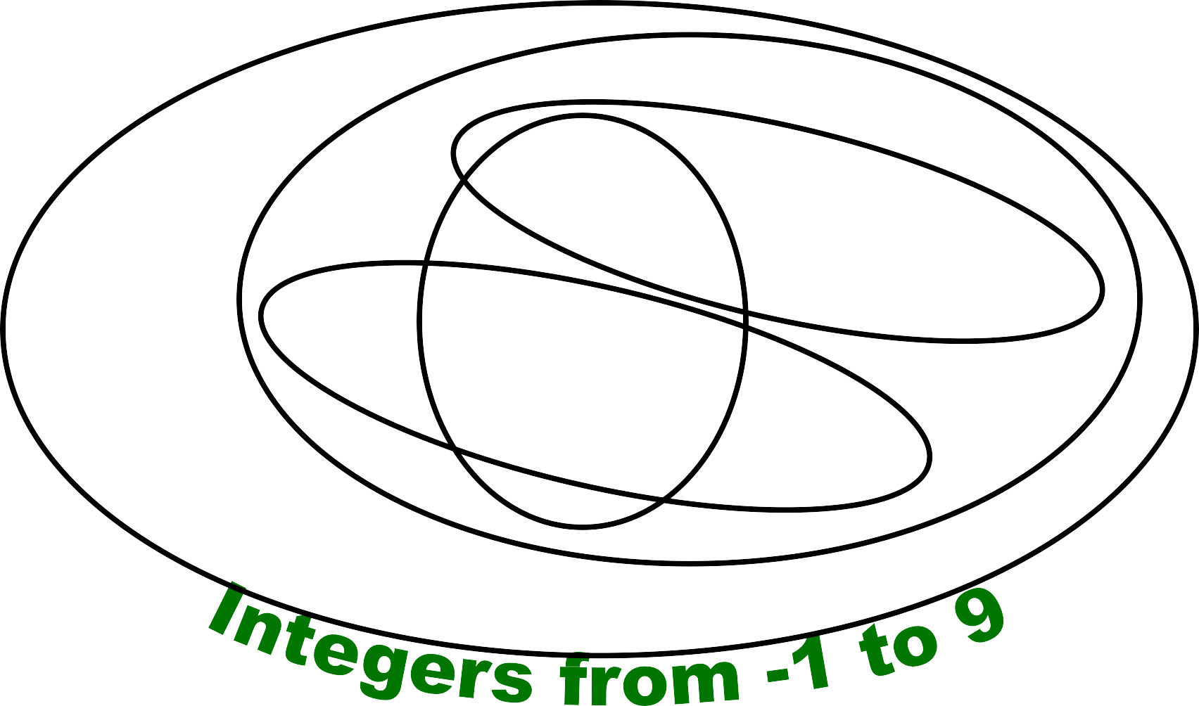



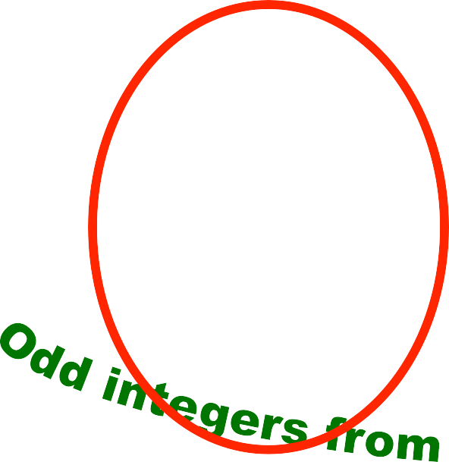































































































Venn Diagrams
.
U

Slide 15

Subset and Superset
.
 S⊆T (“S is a subset of T ”) means that every element of S is also an element of T.
 S⊆T ≡ ∀x (x∈S → x∈T)
 ∅⊆S, S⊆S
 S ⊃ T (“S is a superset of T ”) means T⊆S
 Note (S = T) ≡ (S⊆T ∧ T⊆S)
≡ ∀x(x∈S → x∈T) ∧ ∀x(x∈T → x∈S)
≡ ∀x(x∈S ↔ x∈T)
 S⊆T means ¬(S⊆T), i.e. ∃x(x∈S ∧ x∉T)

Slide 16

Proper (Strict) Subsets &
.
Supersets
 S⊂T (“S is a proper subset of T ”) means that
S⊆T but T⊆S. Similar for S ⊃T.
 Example:
{1, 2} ⊂ {1, 2, 3}
S
T
Venn Diagram of S⊂T

Slide 17



Sets Are Objects, Too!
.
 The objects that are elements of a set may
themselves be sets.
 Example:
Let S = {x | x ⊆ {1, 2, 3}} then S = { ∅,
{1}, {2}, {3},
{1, 2}, {1, 3}, {2, 3},
{1, 2, 3} }
 Note that 1 ≠ {1} ≠ {{1}} !!!!

Slide 18

Cardinality and Finiteness
.
 |S| (read “the cardinality of S”) is a measure of how many different elements S has.
 E.g., |∅| = 0, | {1, 2, 3} | = 3, | {a, b} | = 2,
| { {1, 2, 3}, {4, 5} } | =

Slide 19
The Power Set Operation
.
 The power set P(S) of a set S is the set of all subsets of S. P(S) = {x | x⊆S}.
 Examples
 P({a, b}) = { ∅, {a}, {b}, {a, b} }
 S = {0, 1, 2}
P(S) = {∅, {0}, {1}, {2}, {0, 1}, {0, 2}, {1, 2},
{0, 1, 2}}
 P(∅) = {∅}
 P({∅}) = {∅, {∅}}
 Note that for finite S, |P(S)| = 2^{|S|}.
 It turns out ∀S (|P(S)| > |S|), e.g. |P(N)| > |N|.

Slide 20
Cartesian Products of Sets
.
 For sets A and B, their Cartesian product denoted by A × B, is the set of all ordered pairs (a, b), where a∈A and b∈B. Hence,
A × B = { (a, b) | a∈A ∧ b∈B }.
 E.g. {a, b} × {1, 2}
= { (a, 1), (a, 2), (b, 1), (b, 2) }
 Note that for finite A, B, |A × B| = |A||B|.
 Note that the Cartesian product is not
commutative: i.e., ¬∀A,B (A × B = B × A).
 Extends to A₁ × A₂ × … × A_{n}
= {(a₁, a₂, …, a_{n}) | a_{i} ∈ A_{i} for i = 1, 2,…, n}

Slide 21
The Union Operator
.
 For sets A and B, their union A∪B is the set containing all elements that are either in A, or (“∨”) in B (or, of course, in both).
 Formally, ∀A,B: A∪B = {x | x∈A ∨ x∈B}.
 Note that A∪B is a superset of both A and B
(in fact, it is the smallest such superset):
∀A,B: (A∪B ⊃ A) ∧ (A∪B ⊃ B)

Slide 22









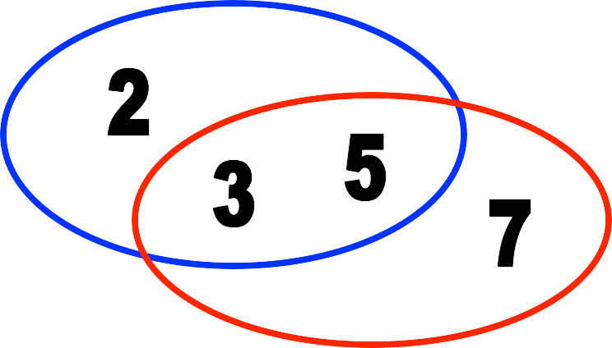
Union Examples
.
 {a, b, c} ∪ {2, 3} = {a, b, c, 2, 3}
 {2, 3, 5} ∪ {3, 5, 7} = {2, 3, 5, 3, 5, 7}
= {2, 3, 5, 7}

Slide 23
The Intersection Operator
.
 For sets A and B, their intersection A∩B is the set containing all elements that are simultaneously in A and (“∧”) in B.
 Formally, ∀A,B: A∩B = {x | x∈A ∧ x∈B}.
 Note that A∩B is a subset of both A and B (in fact it is the largest such subset):
∀A,B: (A∩B ⊆ A) ∧ (A∩B ⊆ B)

Slide 24

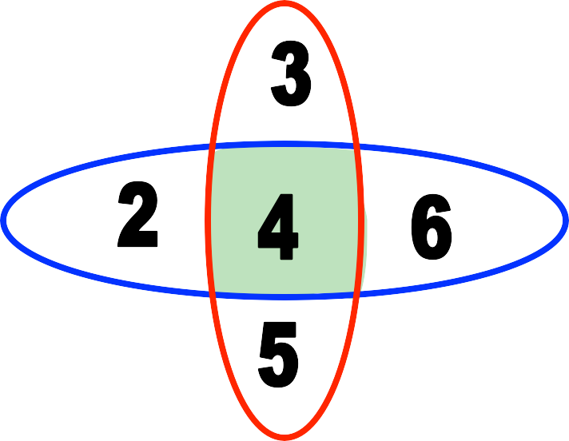
Intersection Examples
.
 {a, b, c} ∩ {2, 3} = ∅
 {2, 4, 6} ∩ {3, 4, 5} = {4}

Slide 25
Disjointedness
.
 Two sets A, B are called disjoint (i.e., unjoined) iff their intersection is empty. (A ∩ B = ∅)
Help, I’ve been disjointed!
 Example: the set of even integers is disjoint with the set of odd integers.

Slide 26
Inclusion-Exclusion Principle.
 How many elements are in A∪B?
|A∪B| = |A| + |B| - |A∩B|
 Example: How many students in the class major in Computer Science or Mathematics?
 Consider set E = C ∪ M,
C = {s | s is a Computer Science major}
M = {s | s is a Mathematics major}
 Some students are joint majors!
|E| = |C ∪ M| = |C| + |M| - |C ∩ M|

Slide 27
Set Difference
.
 For sets A and B, the difference of A and B, written A - B, is the set of all elements that are in A but not B.
 Formally:
A - B = {x | x∈A ∧ x∉B}
= {x | ¬(x∈A → x∈B)}
 Also called:
The complement of B with respect to A.

Slide 28

Set Difference: Venn Diagram.
 A − B
is what’s left after B “takes a bite out of A”
Chomp!
Set
A - B
Set A
Set B

Slide 29
Set Difference Examples
.
 {1, 2, 3, 4, 5, 6} - {2, 3, 5, 7, 9, 11} =
{1, 4, 6}
 Z - N = {… , −1, 0, 1, 2, … } - {0, 1, … }
= {x | x is an integer but not a natural #}
= {… , −3, −2, −1}
= {x | x is a negative integer}

Slide 30
Set Complements
.
 The universe of discourse (or the domain) can itself be considered a set, call it U.
 When the context clearly defines U, we say that for any set A ⊆ U, the complement of A, written as A, is the complement of A with respect to U, i.e., it is U - A.
 E.g., If U = N,
{3, 5} = {0,1, 2, 4, 6, 7,...}

Slide 31
More on Set Complements
.
 An equivalent definition, when U is obvious:
A ={x | x ∉ A}
A
A
A
U

Slide 32
Computer Representation of Sets
.
 How to represent sets in the computer?
• One solution: Data structures like a list
• A better solution:
• First, specify an arbitrary ordering of the elements of U, for instance a1, a2, . . . , an. Represent a subset A of U with the bit string of length n, where the ith bit in this string is 1 if ai belongs to A and is 0 if ai does not belong to A.
Example: All possible elements: U={1 2 3 4 5}
• Assume A={2,5}
– Computer representation: A = 01001
• Assume B={1,5}
– Computer representation: B = 10001

Slide 33
Interval Notation
.
 a, b ∈ R, and a < b then
 (a, b) = {x ∈ R | a < x < b} Open Interval
 [a, b] = {x ∈ R | a ≤ x ≤ b} Closed Interval
 (a, b] = {x ∈ R | a < x ≤ b}
 (–∞, b] = {x ∈ R | x ≤ b}
 [a, ∞) = {x ∈ R | a ≤ x}
 (a, ∞) = {x ∈ R | a < x}

Slide 34

Set Identities
.
 Identity:
 Domination:
 Idempotent:
A ∪ ∅ = A = A ∩ U
A ∪ U = U , A ∩ ∅ = ∅
A ∪ A = A , A ∩ A = A
 Double complement: (A) = A
 Commutative: A ∪ B = B ∪ A, A ∩ B = B ∩ A
 Associative:
A ∪ (B ∪ C) = (A ∪ B) ∪ C, A ∩ (B ∩ C) = (A ∩ B) ∩ C
A ∩ (B ∪ C) = (A ∩ B) ∪ (A ∩ C),
A ∪ (B ∩ C) = (A ∪ B) ∩ (A ∪ C)
A ∪ (A ∩ B) = A, A ∩ (A ∪ B) = A
 Distributive:
 Absorption:
 Complement: A ∪ A = U, A ∩ A = ∅

Slide 35
DeMorgan’s Law for Sets
.
 Exactly analogous to (and provable from) DeMorgan’s Law for propositions.
A ∪ B = A ∩ B A ∩ B = A ∪ B

Slide 36
Proving Set Identities
.
 To prove statements about sets, of the form E₁ = E₂ (where the Es are set expressions), here are three useful techniques:
Use set builder notation & logical equivalences.
Use a membership table.
Use a Venn diagram.

Slide 37

Method 1: Set Builder Notation
& Logical Equivalence
.
 S h o w
A ∩ B = A ∪ B
A ∩ B = {x | x ∉( A ∩ B)}
= {x | ¬(x ∈( A ∩ B))}
= {x | ¬(x ∈ A ∧ x ∈ B)}
def. of complement
def. of “does not belong”
def. of intersection
= {x | ¬(x ∈ A) ∨ ¬(x ∈ B)}
De Morgan’s law (logic)
= {x | x ∉ A ∨ x ∉ B}
= {x | x ∈ A ∨ x ∈ B}
= {x | x ∈ A ∪ B}
= A ∪ B
def. of “does not belong”
def. of complement
def. of union
by set builder notation

Slide 38
Method 2: Membership Table s
 Analog to truth tables in propositional logic.
 Columns for different set expressions.
 Rows for all combinations of memberships in constituent sets.
 Use “1” to indicate membership in the derived set, “0” for non-membership.
 Prove equivalence with identical columns.

Slide 39
Membership Table Example
.
 Prove (A ∪ B) - B = A - B.
A | B | A∪B | (A∪B)−B | A−B
1 | 1 | 1 | 0 | 0
1 | 0 | 1 | 1 | 1
0 | 1 | 1 | 0 | 0
0 | 0 | 0 | 0 | 0

Slide 40
Membership Table Exercise
.
 Prove (A ∪ B) - C = (A - C) ∪ (B - C).
A B C | A∪B | (A∪B)−C | A−C | B−C | (A−C)∪(B−C)
1 1 1 | 1 | 0 | 0 | 0 | 0
1 1 0 | 1 | 1 | 1 | 1 | 1
1 0 1 | 1 | 0 | 0 | 0 | 0
1 0 0 | 1 | 1 | 1 | 0 | 1
0 1 1 | 1 | 0 | 0 | 0 | 0
0 1 0 | 1 | 1 | 0 | 1 | 1
0 0 1 | 0 | 0 | 0 | 0 | 0
0 0 0 | 0 | 0 | 0 | 0 | 0

Slide 41



Method 3: Venn Diagram
.
 Prove (A ∪ B) - C = (A - C) ∪ (B - C).
A A
B
C
B C
A ∪ B
(A ∪ B) – C
A
A
A
B
C B
C
B C
A – C
B – C
(A – C) ∪ (B – C)

Slide 42
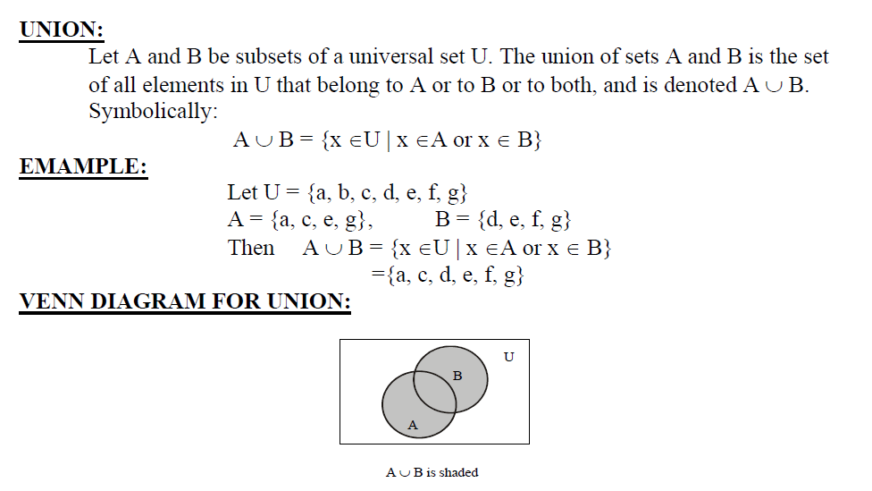
Venn Diagram
.

Slide 43
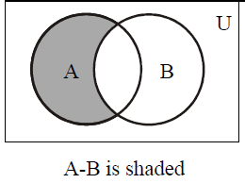
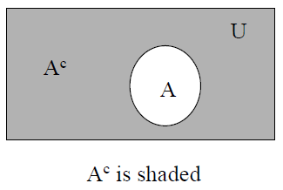
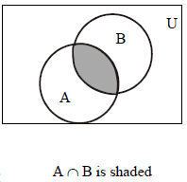
Venn Diagram
.

Slide 44
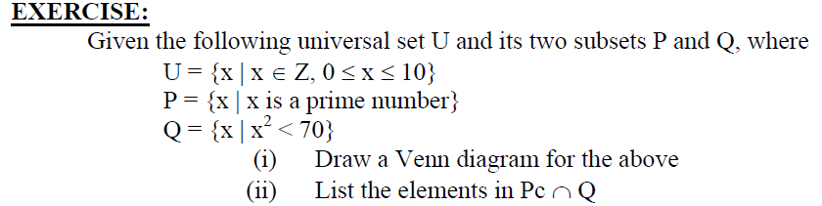
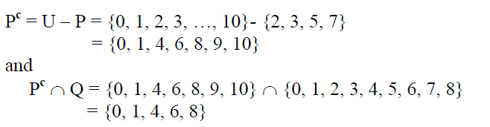
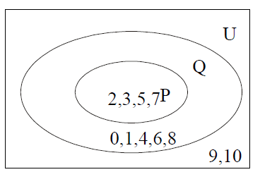
Venn Diagram
.

Slide 45
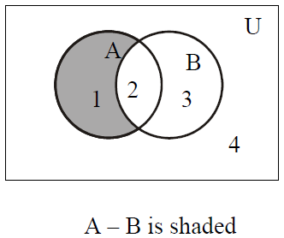
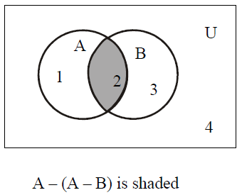
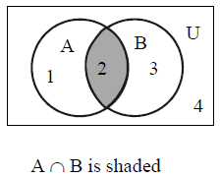
Proving Set Identities by Venn Diagram
.
 Prove the following using Venn Diagrams:
(i) A – (A – B) = A ∩ B
(ii) (A ∩ B)^{c} = A^{c} ∪ B^{c}
(iii) A – B = A ∩ B^{c}
A = { 1, 2 }
B = { 2, 3 }

Slide 46
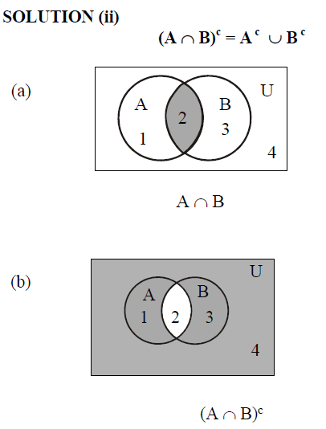
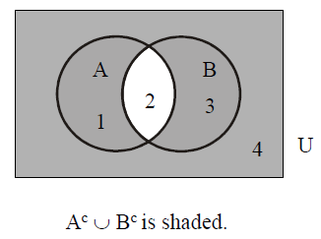
Proving Set Identities by Venn Diagram
.

Slide 47
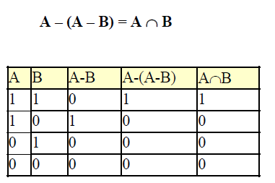
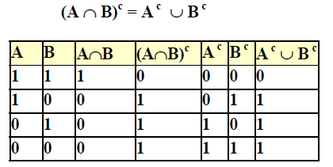
Proving Set Identities by Membership Table
.
 Prove the following using Membership Table:
(i) A – (A – B) = A ∩ B
(ii) (A ∩ B)^{c} = A^{c} ∪ B^{c}
(iii) A – B = A ∩ B^{c}
A = { 1, 2 }
B = { 2, 3 }

Slide 48
Applications of Venn Diagram
.
 A number of computer users are surveyed to find out if they have a printer, modem or scanner. Draw separate Venn diagrams and shade the areas,
which represent the following configurations:
(i) modem and printer but no scanner
(ii) scanner but no printer and no modem
(iii) scanner or printer but no modem.
(iv) no modem and no printer.
Let
P represent the set of computer users having printer.
M represent the set of computer users having modem.
S represent the set of computer users having scanner.

Slide 49
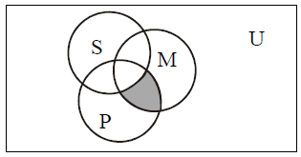
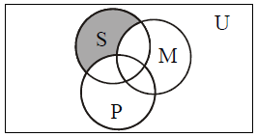
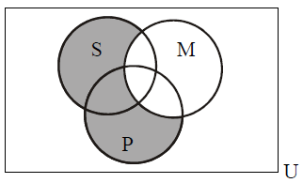
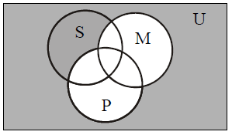
Applications of Venn Diagram
.


Slide 50
Applications of Venn Diagram
.
 Do Yourself!
Of 21 typists in an office, 5 use all manual typewriters (M), electronic typewriters (E) and word processors (W); 9 use E and W; 7 use M and W; 6 use M and E; but no one uses M only.
(i) Represent this information in a Venn Diagram.
(ii) If the same number of typists use electronic as use
word processors, then
1. (a) How many use word processors only,
2. (b) How many use electronic typewriters?

